Slide 1
NSQ1, Session 5
The Aggregation Pipeline

Slide 2
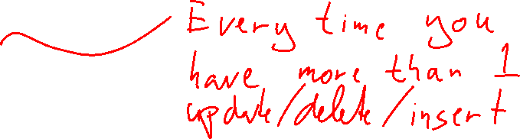
MongoDB Transactions
let session = db.getMongo().startSession()
session.startTransaction()
// … updates here
session.commitTransaction()

Slide 3
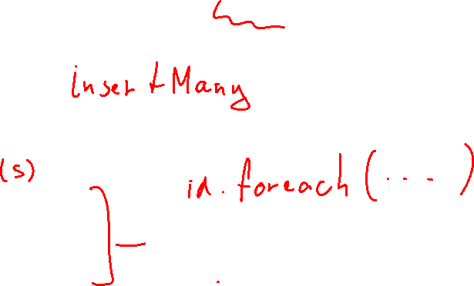
Inserted ids
let id = db.parent.insertOne({
date: Date()
}).insertedId
db.child.insertOne({
text: "Hello",
test_id: id
})

Slide 4
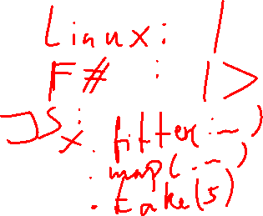
Stage
A stage is function on a collection, returning a new collection
Example: {$match: {"user.username": "harry"}}
Returns a collection with only the documents that have "user.username" as "harry"
This means that you can plug stages together
The output of one stage is the input of the next
This is called the aggregation pipeline

Slide 5
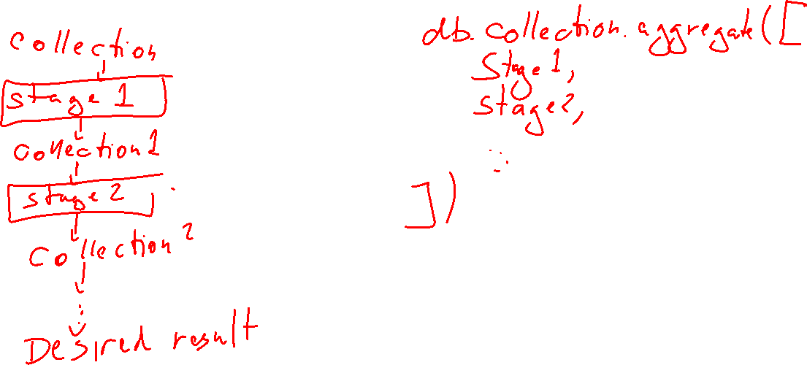
Aggregation pipeline

Slide 6
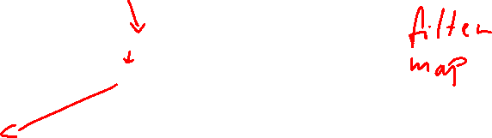
$match, $project
Instead of db.collection.find(<match>, <project>)
db.collection.aggregate( [ {$match: <match>}, {$project: <project>} ])

Slide 7
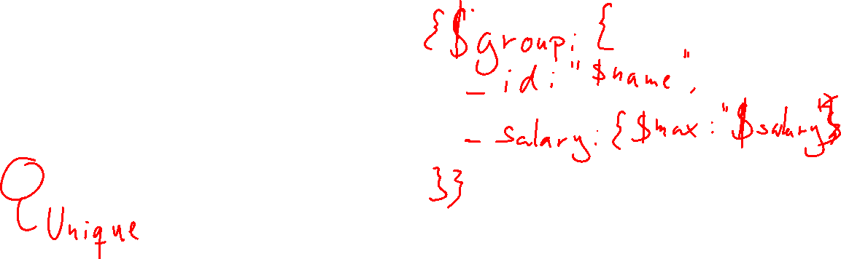
$group
Like GROUP BY
Specify:
What you're grouping by
All the aggregations
_id: It's what you're grouping by

Slide 8
Equivalent of HAVING
Two stages
$group, then
$match

Slide 9

$unwind
Turns an object with an array into a collection of objects without an array.
collection: [{x: 7, ys: [1, 2, 3]}, {x: 8, ys: [2]}, {x: 9, ys: []}]
unwound: [{x: 7, ys: 1}, {x: 7, ys:2}, {x:7, ys: 3}, {x:8, ys:2}]

Slide 10
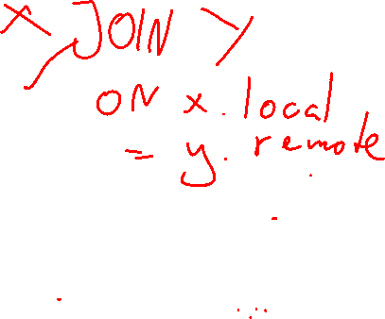
$lookup
Merging data with data from other collection
Specify:
The other collection
The field in this collection to match on (local field)
The field in other collection to match on (foreign field)
The new field to store the results
The new field will be an array of matching objects (empty if nothing matches)
Similar to a LEFT JOIN

Slide 11
Equivalent of INNER JOIN
First $lookup, then $unwind
Equivalent of LEFT JOIN:
First $lookup, then $unwind with preserveNullAndEmptyArrays: true

Slide 12
$graphLookup
Similar to $lookup, but recursive
Output similar to Tree Pattern (MongoDB Design Pattern)
Details left as an exercise to the reader

